Slide 1
01.23.20
assignment01 - Turn In
Java
assignment 02 Kickoff
Read the problem
How to estimate pi
Demo working pi estimator program

Slide 2
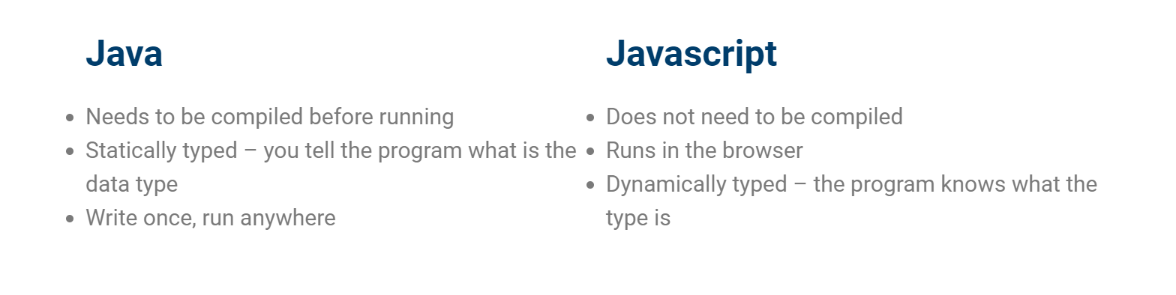
Java vs Javascript
Notes:
Print out syllabus
Print out BJ syllabus, read from his

Slide 3
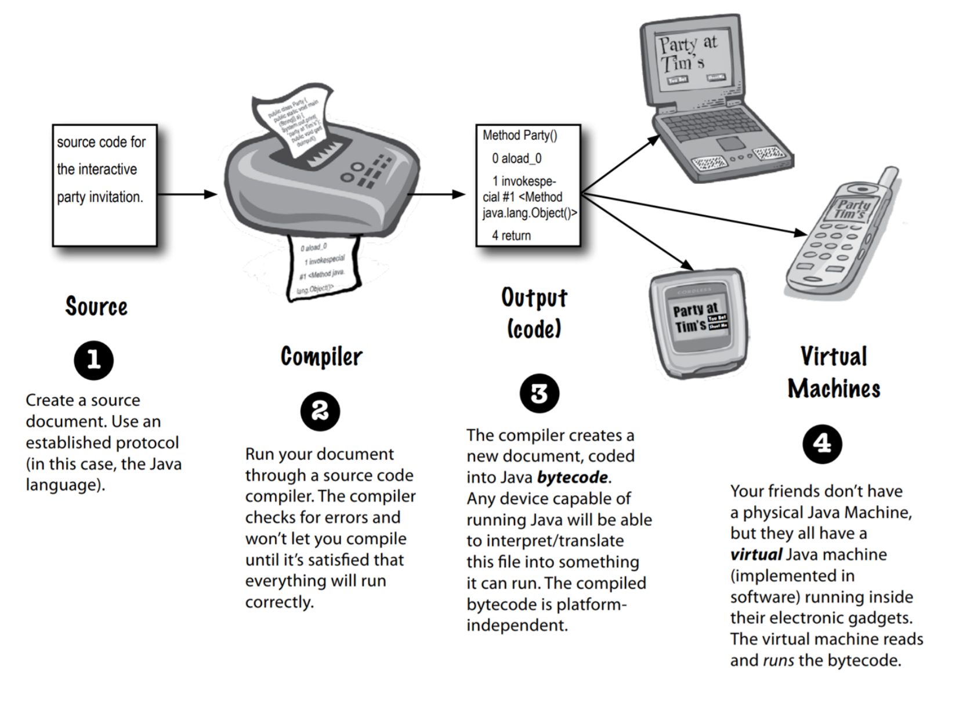
Compiled
Notes:
Print out syllabus
Print out BJ syllabus, read from his

Slide 4
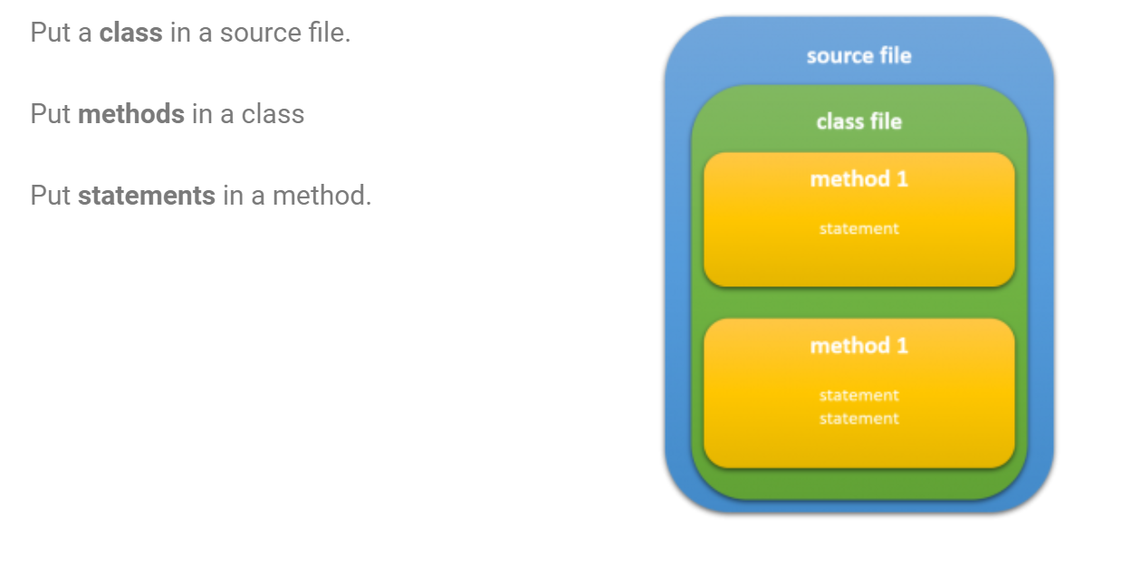
Program Structure
Notes:
Print out syllabus
Print out BJ syllabus, read from his

Slide 5
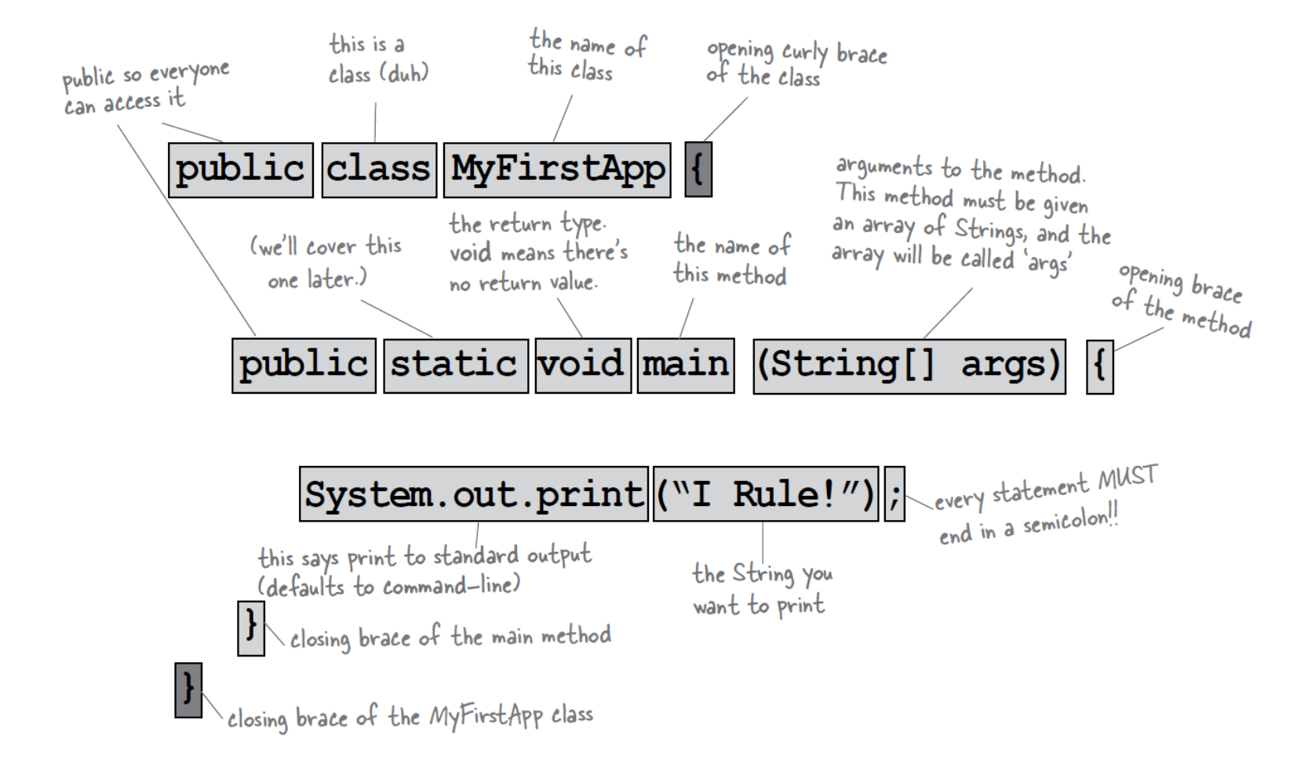
Class Structure
Notes:
Print out syllabus
Print out BJ syllabus, read from his

Slide 6
Class Structure
Notes:
Print out syllabus
Print out BJ syllabus, read from his

Slide 7
Data Types
https://docs.oracle.com/javase/tutorial/java/nutsandbolts/
datatypes.html
Primitive Type | Description | Example Values of the Type
boolean | The two values true and false | false
char | Supposedly characters, but not quite | 'π'
byte | Integers in the range -128 ... 127 | (byte)89
short | Integers in the range -32768 ... 32767 | (short)89
int | Integers in the range -2147483648 ... 2147483647 | 89
long | Integers in the range -9223372036854775808 ... 9223372036854775807 | 89L
float | Lower precision floating point numbers | 3.95f
double | Higher precision floating point numbers | 3.95
Notes:
Print out syllabus
Print out BJ syllabus, read from his

Slide 8
Primitive Data Types
https://docs.oracle.com/javase/tutorial/java/nutsandbolts/
datatypes.html
Where are the strings???? They are not a primitive data type.
They are a special type, created with classes.
But you can instantiate them in the same way
String x = “hello”;
Notes:
Print out syllabus
Print out BJ syllabus, read from his

Slide 9
Declare and assign
type name = value;
int numTimes = 4;
double amount = 2.99;
byte smallNumber = 5;
char firstLetter = ‘a’;
String greeting = “hello there”;
Notes:
Print out syllabus
Print out BJ syllabus, read from his

Slide 10
Variables
Use var to create a variable. A type is assigned at instantiation.
var x = 4;
Try it in jshell
jshell> var x = 4;
jshell> x = 5;
jshell> x = “hello”;
Notes:
Print out syllabus
Print out BJ syllabus, read from his

Slide 11
Variables
Instantiate a variable with the type
jshell> int x = 4;
jshell> boolean isItTrue = true;
jshell> String hi = “hello”;
Notes:
Print out syllabus
Print out BJ syllabus, read from his

Slide 12
Variables
If you write methods (functions), you have to specify types for parameters and return values
jshell> boolean isEven ( int n ) { return n % 2 == 0 }
jshell> isEven(234098)
Notes:
Print out syllabus
Print out BJ syllabus, read from his

Slide 13
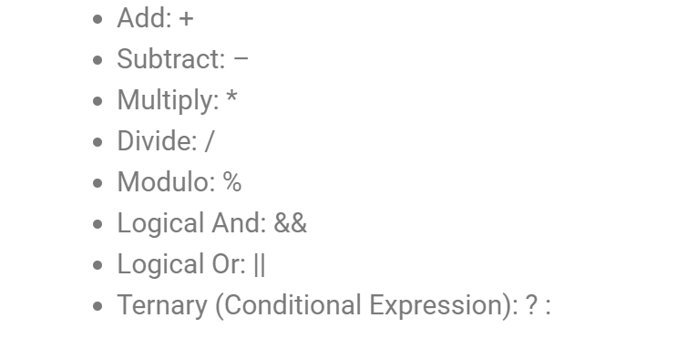
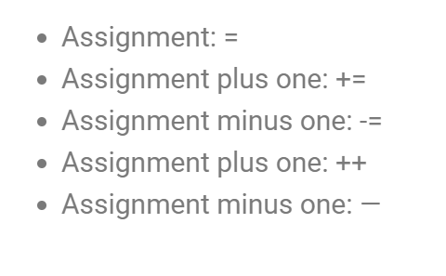
Operators
https://docs.oracle.com/javase/tutorial/java/nutsandbolts/operators.html
Notes:
Print out syllabus
Print out BJ syllabus, read from his

Slide 14
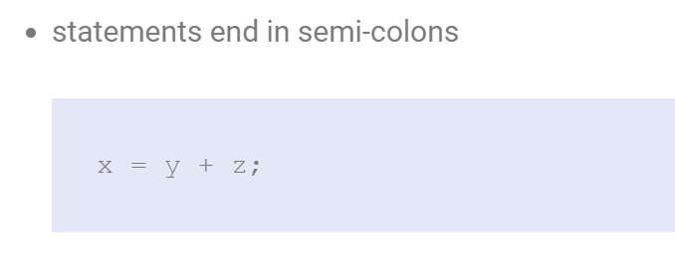
Similar to Javascript
Notes:
Print out syllabus
Print out BJ syllabus, read from his

Slide 15
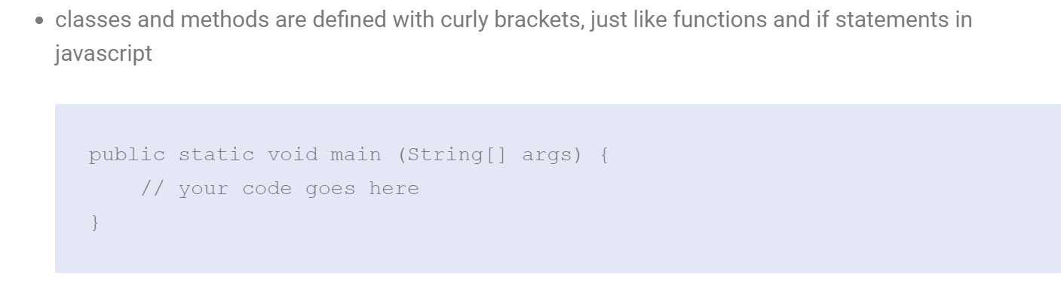
Similar to Javascript
Notes:
Print out syllabus
Print out BJ syllabus, read from his

Slide 16

Similar to Javascript
Notes:
Print out syllabus
Print out BJ syllabus, read from his

Slide 17
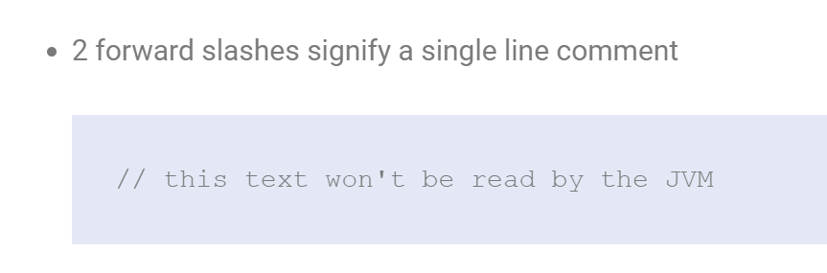
Similar to Javascript
Notes:
Print out syllabus
Print out BJ syllabus, read from his

Slide 18
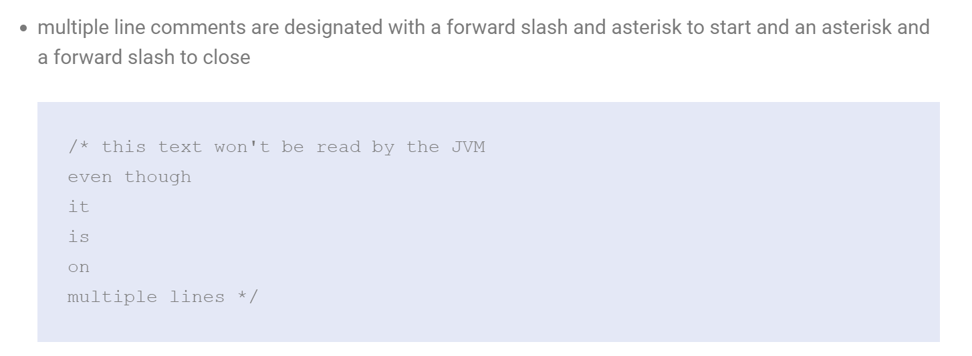
Similar to Javascript
Notes:
Print out syllabus
Print out BJ syllabus, read from his

Slide 19
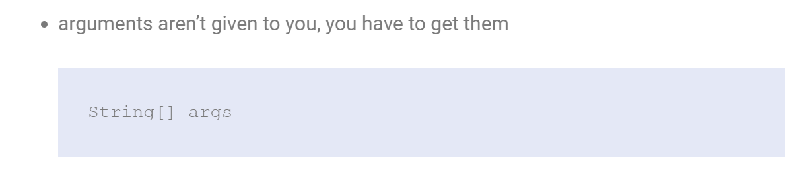
Different from Javascript
Notes:
Print out syllabus
Print out BJ syllabus, read from his

Slide 20
Different from Javascript
Notes:
Print out syllabus
Print out BJ syllabus, read from his

Slide 21
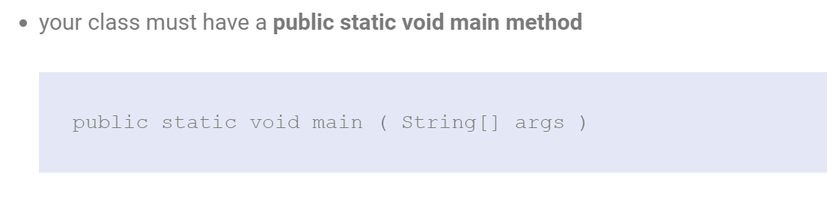
Different from Javascript
Notes:
Print out syllabus
Print out BJ syllabus, read from his

Slide 22
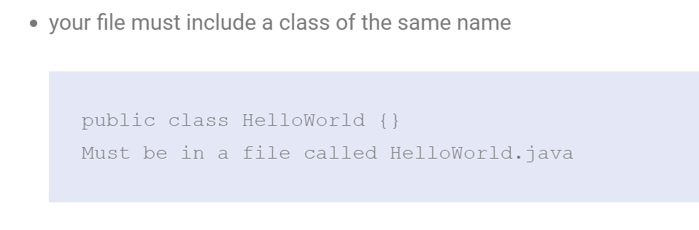
Different from Javascript
Notes:
Print out syllabus
Print out BJ syllabus, read from his

Slide 23
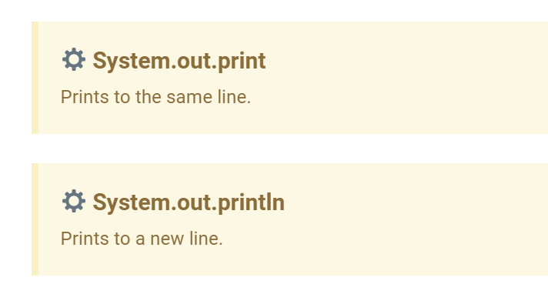
Printing to the Console
Notes:
Print out syllabus
Print out BJ syllabus, read from his

Slide 24
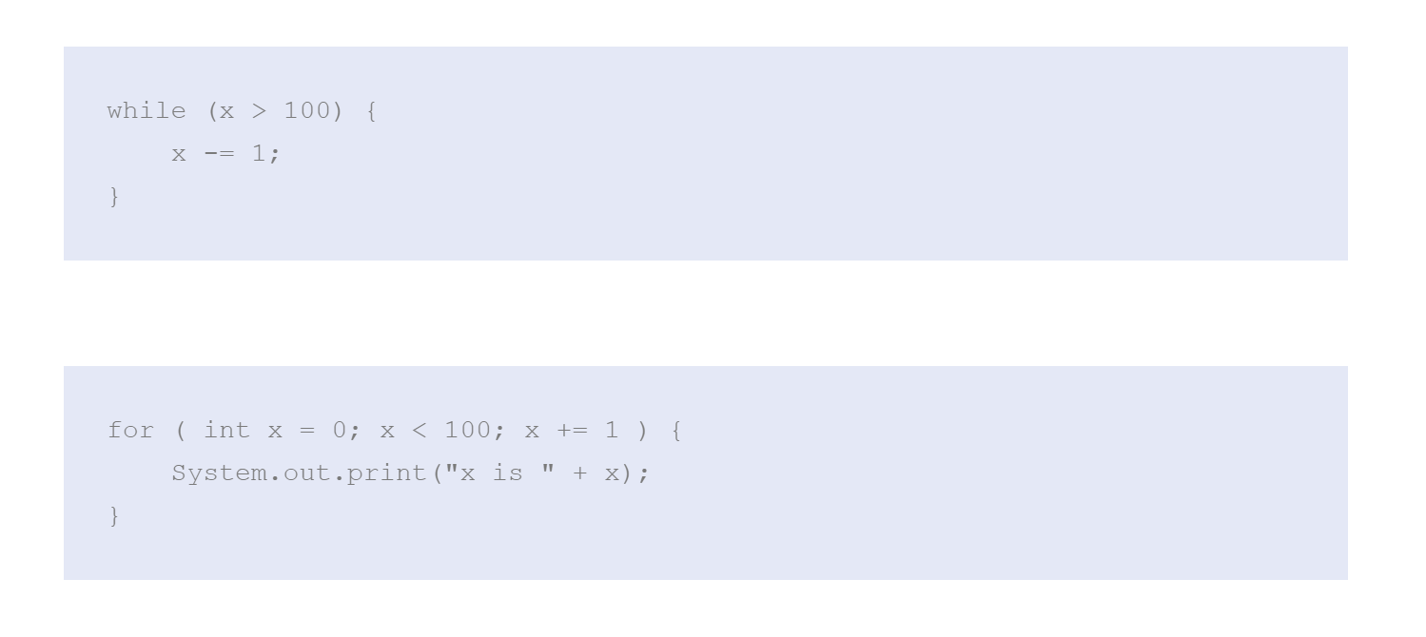
Loops (while, do-while, for)
Notes:
Print out syllabus
Print out BJ syllabus, read from his

Slide 25
Let’s try it out - WhatIsItDoing.java
Notes:
Print out syllabus
Print out BJ syllabus, read from his

Slide 26
Assignment02 - Estimating Pi
Read the assignment and check out the animation on the assignment02 page.
Notes:
Print out syllabus
Print out BJ syllabus, read from his

Slide 27
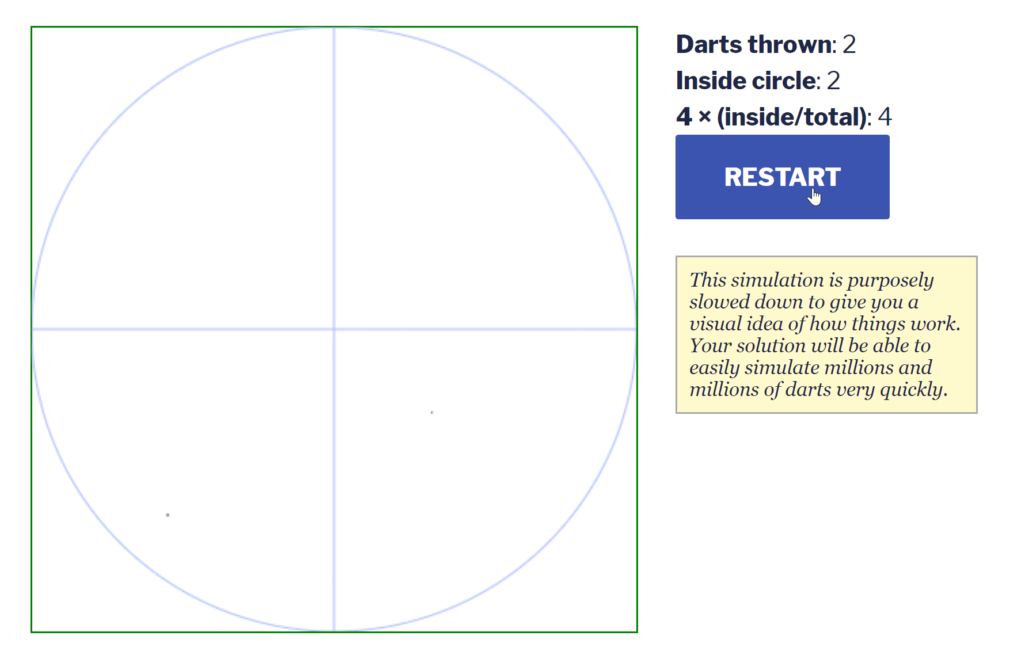
Assignment02 - Estimating Pi
Notes:
Print out syllabus
Print out BJ syllabus, read from his

Slide 28
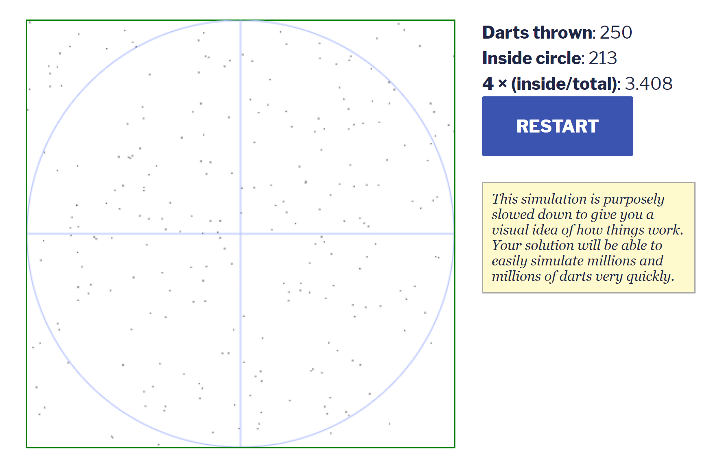
Assignment02 - Estimating Pi
Notes:
Print out syllabus
Print out BJ syllabus, read from his

Slide 29
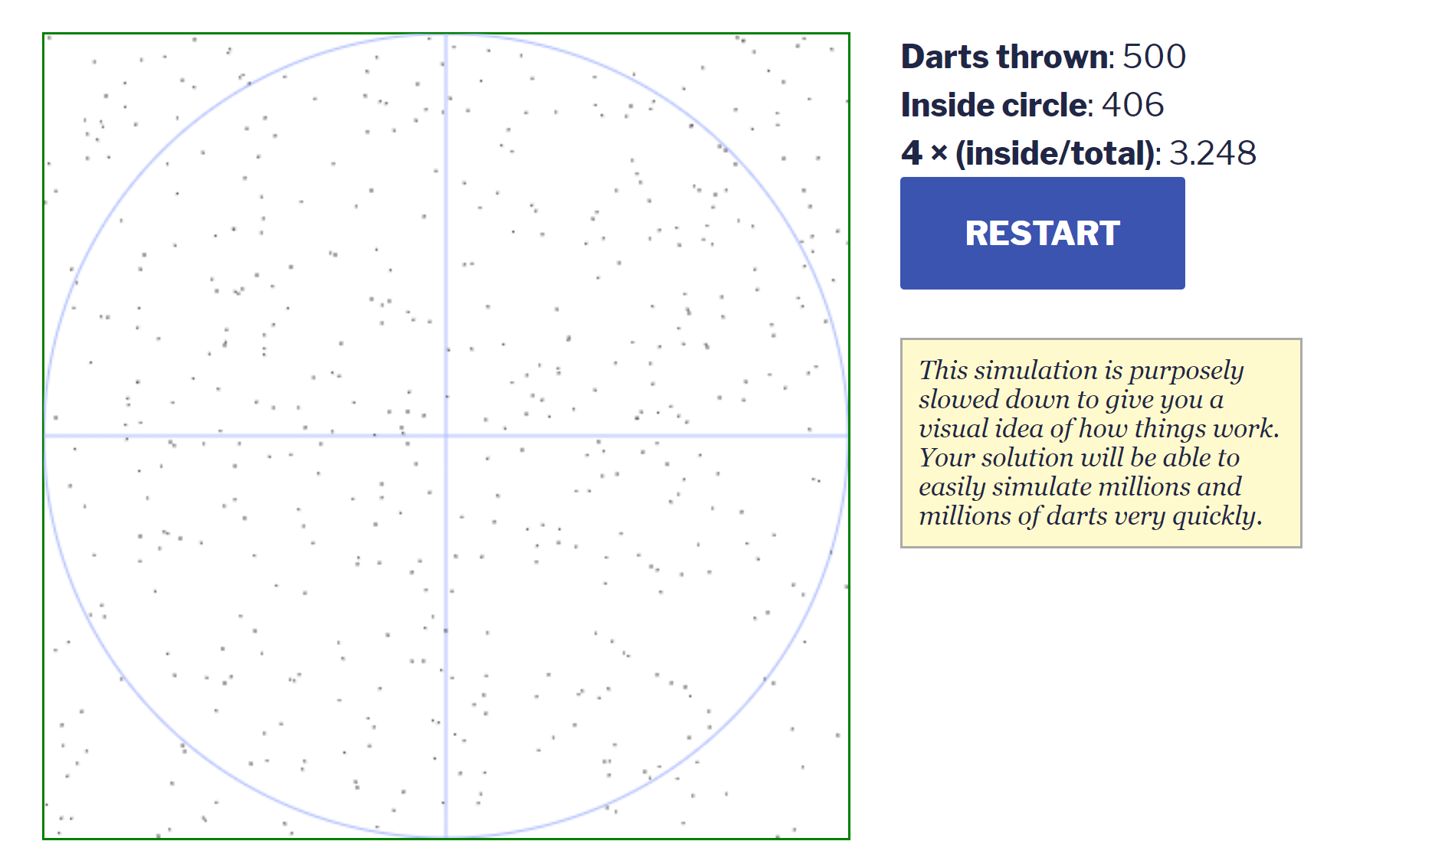
Assignment02 - Estimating Pi
Notes:
Print out syllabus
Print out BJ syllabus, read from his

Slide 30
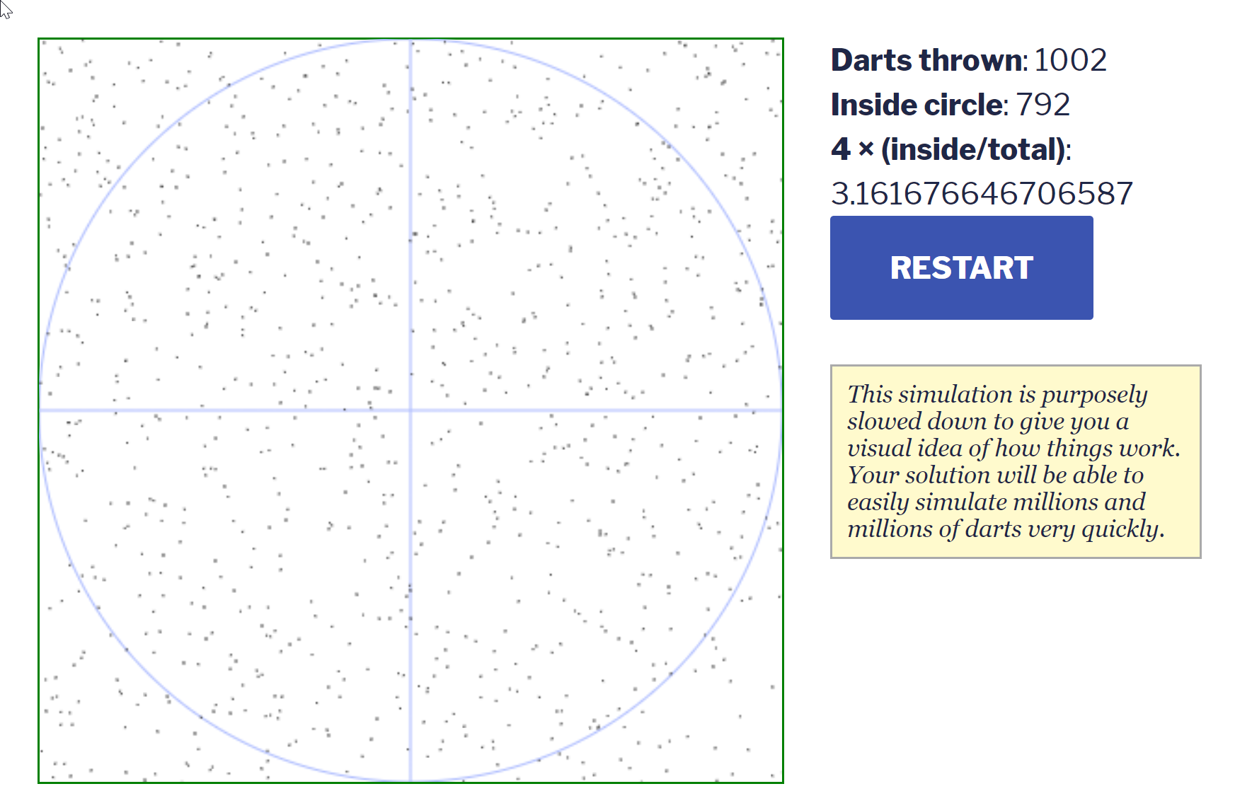
Assignment02 - Estimating Pi
Notes:
Print out syllabus
Print out BJ syllabus, read from his

Slide 31
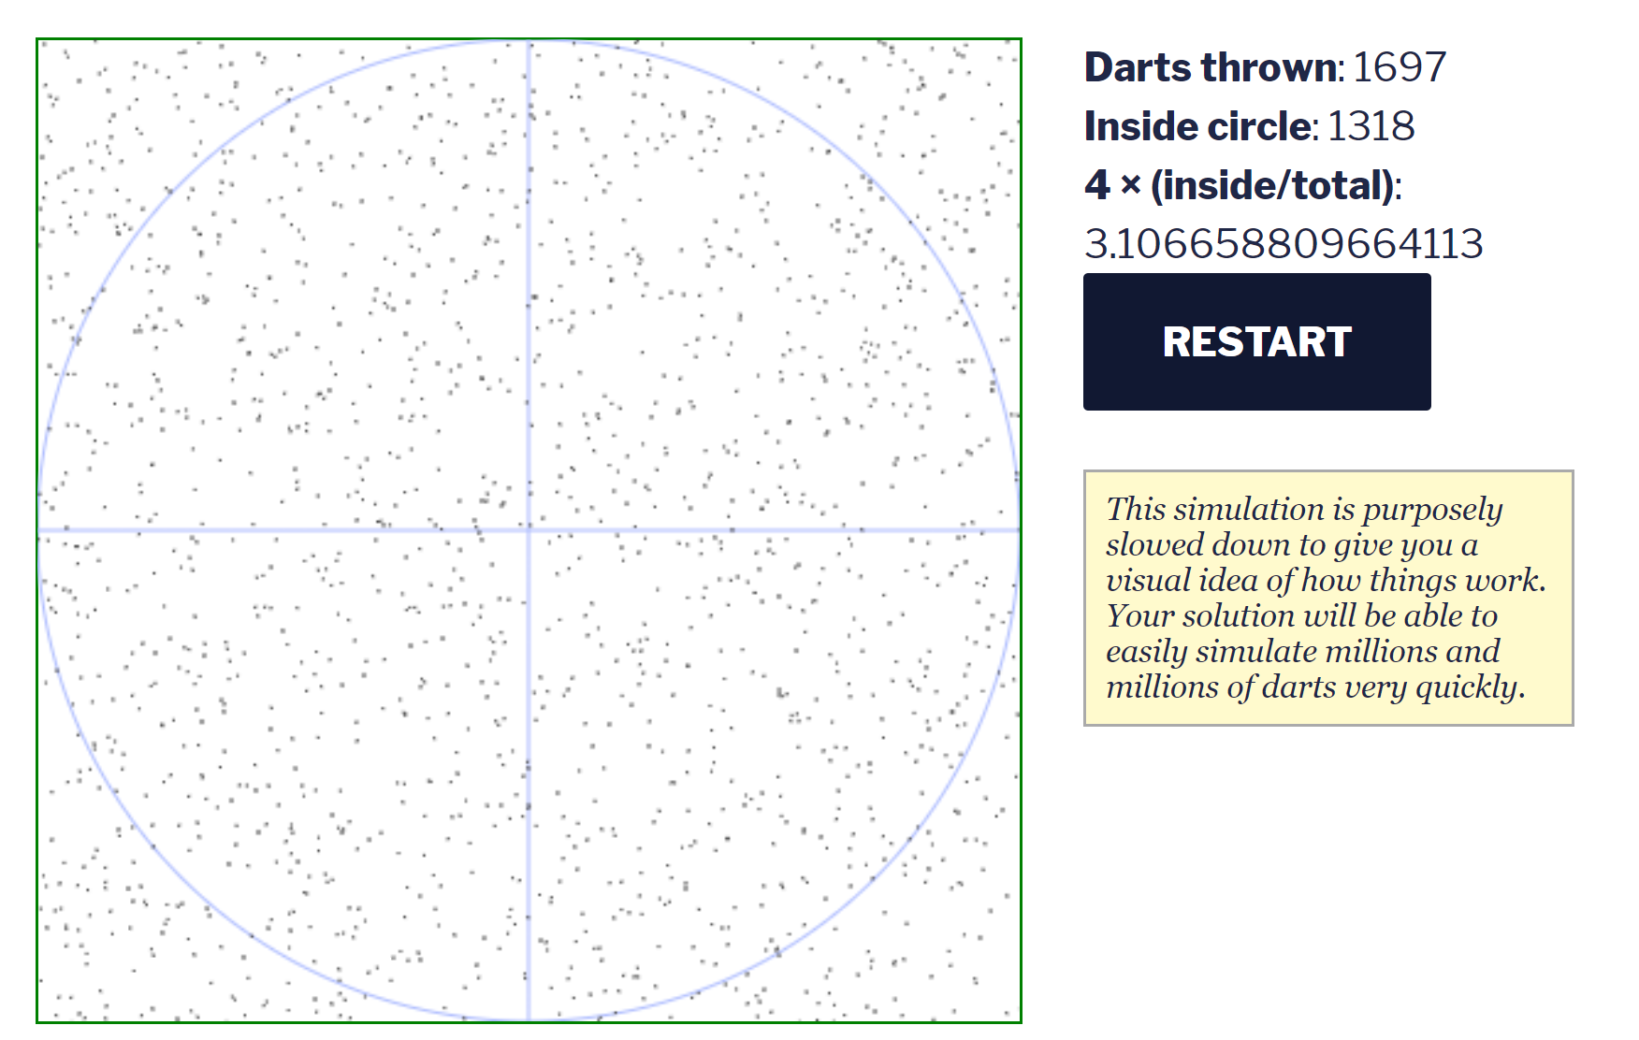
Assignment02 - Estimating Pi
Notes:
Print out syllabus
Print out BJ syllabus, read from his

Slide 32
Assignment02 - Estimating Pi
4 * numInCircle / numDartThrows = piEstimate
Notes:
Print out syllabus
Print out BJ syllabus, read from his

Slide 33
Is the dart in the circle?
Notes:
Print out syllabus
Print out BJ syllabus, read from his

Slide 34
Is the dart in the circle?
Put the circle on an x,y axis
(2,0)
(1,0)
(0,0)
(0,1)
(0,2)
Notes:
Print out syllabus
Print out BJ syllabus, read from his

Slide 35
Is the dart in the circle?
What is the radius of the circle?
(2,0)
(1,1)
(1,0)
(0,0)
(0,1)
(0,2)
Notes:
Print out syllabus
Print out BJ syllabus, read from his

Slide 36
Is the dart in the circle?
What is the radius of the circle?
(2,0)
1
(1,0)
(0,0)
(0,1)
(0,2)
Notes:
Print out syllabus
Print out BJ syllabus, read from his

Slide 37
Is the dart in the circle?
What is the area of the square?
(2,0)
(1,0)
(0,0)
(0,1)
(0,2)
Notes:
Print out syllabus
Print out BJ syllabus, read from his

Slide 38
Is the dart in the circle?
What is the area of the square?
(2,0)
4
(1,0)
(0,0)
(0,1)
(0,2)
Notes:
Print out syllabus
Print out BJ syllabus, read from his

Slide 39
Is the dart in the circle?
How do I know if the dart is in the circle?
(2,0)
(1,0)
(0,0)
(0,1)
(0,2)
Notes:
Print out syllabus
Print out BJ syllabus, read from his

Slide 40
Is the dart in the circle?
Every dart throw has an ( x, y ) coordinate.
For each dart throw, for each x and y coordinate:
(2,0)
(1,0)
Math.random() * 2
(0,0)
(0,1)
(0,2)
Notes:
Print out syllabus
Print out BJ syllabus, read from his

Slide 41
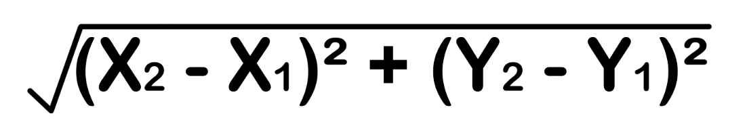
Is the dart in the circle?
How do I know if the dart is in the circle?
(2,0)
(1,0)
(0,0)
(0,1)
(0,2)
Notes:
Print out syllabus
Print out BJ syllabus, read from his

Slide 42
Is the dart in the circle?
How do I know if the dart is in the circle?
(2,0)
(1,0)
The distance between the point and the center of the circle should be less than the circle’s radius!
(0,0)
(0,1)
(0,2)
Notes:
Print out syllabus
Print out BJ syllabus, read from his

Slide 43
How do we turn this into code?
Let’s see it in action!
Notes:
Print out syllabus
Print out BJ syllabus, read from his

Slide 44
Write out the steps that your program needs to go through
Notes:
var PiEstimator = function ( numDarts ) {
let x = 0,
y = 0,
numInCircle =0;
for( let i = 0; i < numDarts; i++ ){
x = Math.random() * 2;
y = Math.random() * 2;
if ( Math.sqrt(Math.pow(x-1, 2)+Math.pow(y-1, 2) ) <= 1 ) {
numInCircle++;
}
}
console.log(numInCircle);
return 4*( numInCircle / numDarts );
}

Slide 45
Algorithm
Initialize some variables we need later
x
y
numDartsInCircle
For each dart up until totalDartThrows
Get an x value
Get a y value
If dart is in circle
Add 1 to numDartsInCircle
Return 4 * numDartsInCircle / totalDartThrows
Notes:
Print out syllabus
Print out BJ syllabus, read from his

Slide 46
If we have time, let’s open the template
Notes:
Print out syllabus
Print out BJ syllabus, read from his

Slide 47
For next time
Do parts 1 and 7 of the homework.
Make sure your PiEstimator.java is in the right folder ready to work on!
Notes:
Print out syllabus
Print out BJ syllabus, read from his

